Slide 1
Archeological Evidence

Slide 2
It’s fortunate that we don’t have to rely on textual evidence alone, particularly since NONE of the information about the earliest Celts is from a Celtic source. And since the other peoples of the time didn’t have an altogether favorable impression of the Celts, their point of view may have been somewhat skewed. (That’s definitely the opinion of scholars who love the Celts.)
The earliest evidence of Celtic civilization was found during excavations at Hallstatt, a small town in Austria. The oldest items in the graves (of those buried, not cremated) there date to 800-600 B.C. That was the Iron Age, so most of the weapons were iron swords. There were also shields, helmets, spearheads, and axes. There were even some large wooden wagons, along with evidence that some people were buried sitting in these wagons. Wagons were eventually replaced by war chariots.

Slide 3
In the later Hallstatt period (600-450 B.C.), graves contain more wealth. The objects found in different graves are a clear indication of a societal hierarchy. (This hierarchy actually began to emerge earlier.) Perhaps the most magnificent of these graves “included a funerary wagon, a bronze couch, gold-covered shoes, drinking horns and other feasting gear and imported luxury metalwork, including a Greek bronze cauldron” (Haywood, The Celts : Bronze Age to New Age http://ebookcentral.proquest.com/lib/gordonstate/detail.action?docID=1733985). Some graves were topped with stone sculptures, one notably of a warrior naked except for a helmet, which prompted classical writers to comment on the presumed Celtic practice of going into battle naked.
Most importantly for those of us interested in modern Celtic culture, “Hallstatt craftsmen borrowed and adapted decorative elements from Mediterranean metalwork and incorporated them into a rich mix of native and Scythian influences to create their own distinctive geometrical, vegetal and animal ornaments that mark the emergence of Celtic art” (Haywood, John. The Celts : Bronze Age to New Age http://ebookcentral.proquest.com/lib/gordonstate/detail.action?docID=1733985). The influence of other cultures is significant. In spite of the fact that they couldn’t fly to the Mediterranean & return with a 50-lb. suitcase full of souvenirs, they did travel & trade quite a bit, as did other peoples of the period.

Slide 4
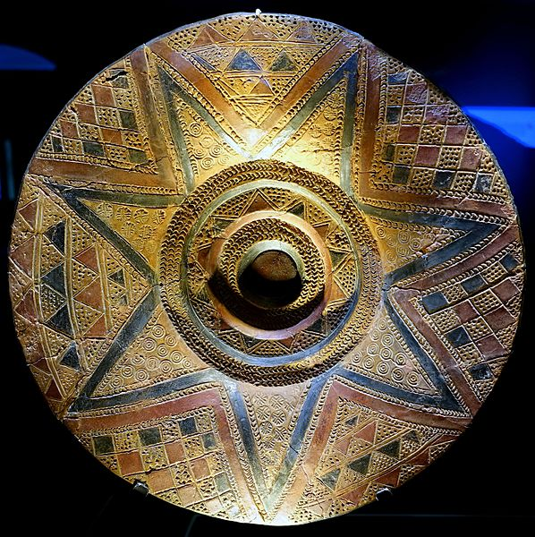
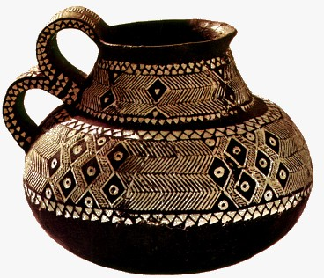
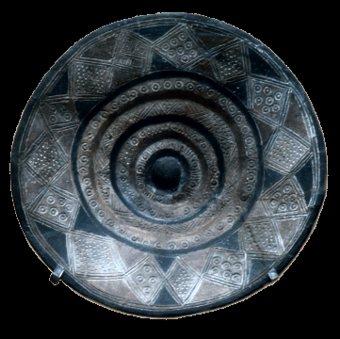
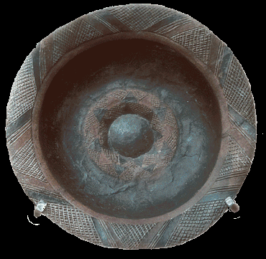
http://www.afhalifax.ca/magazine/wp-content/sciences/VillesFrancaises/annonce_alsace.htm
in the Landesmuseum Württemberg
Hallstatt artifacts
http://www.ceramicstudies.me.uk/frame1tu7.html#HC07-Pic.001
http://www.ceramicstudies.me.uk/frame1tu7.html#HC07-Pic.001

Slide 5
Any real celtophile has to be familiar with an enormous archeological find at the eastern end of Lake Neuchâtel in Switzerland. In 1857, a Swiss archeologist found a virtual treasure trove of Celtic artifacts, and those artifacts gave birth to what is now called La Tène (“The Shallows”) culture.
The 2500+ artifacts date to the late Iron Age (450 – 50 B.C.). This culture apparently “developed when Celtic traders – and warriors -- came into contact with Greek and Etruscan influences from south of the Alps. The culture grew and spread in eastern France, Switzerland, Austria, southwestern Germany, the Czech Republic, Slovakia and Hungary” (https://www.swissinfo.ch/eng/unearthing-la-t%C3%A8ne-s-celtic-mysteries/5776464). There were more weapons than anything, but there were also jewelry, tools, & pottery. Significantly, many artifacts were decorated with swirling designs that have become known as Celtic designs.

Slide 6
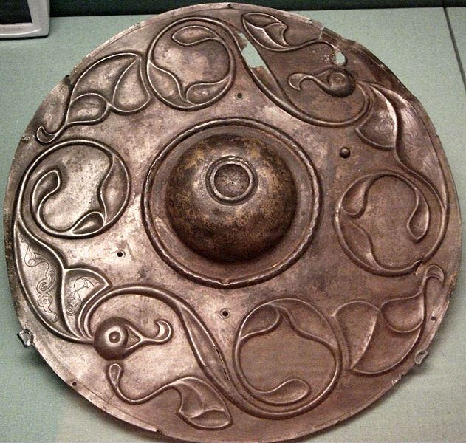
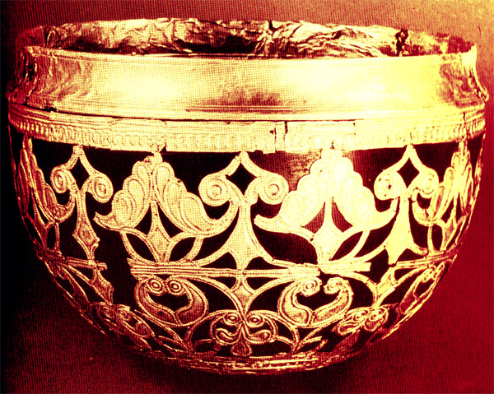
La Tène Artifacts
Finding pictures of actual artifacts from the La Tène site is not as easy as you might think, especially considering how many were found. When you google “La Tène artifacts” and specify “images,” you get a lot, but when you look carefully, you see that they aren’t actually from that archaeological site. “La Tène” has become virtually synonymous with the art style found decorating the artifacts, so you’ll find items considered to be La Tène that are from countries besides Switzerland & time periods besides 450 – 50 B.C. The items below, however, are actually from the real La Tène site in Switzerland.
Wandsworth Shield
Gold Schwarzenbach Cup

Slide 7
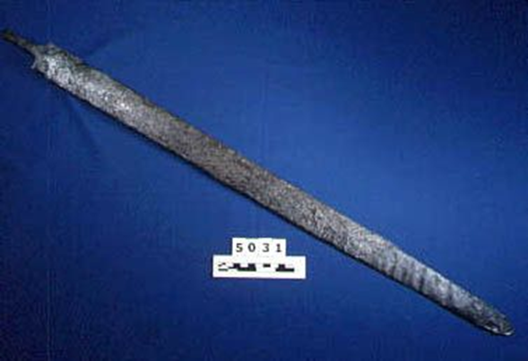
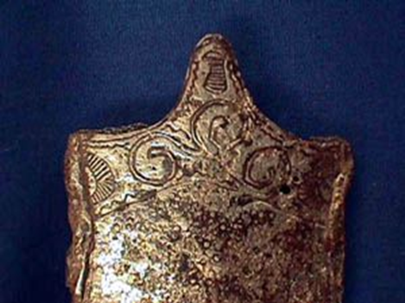
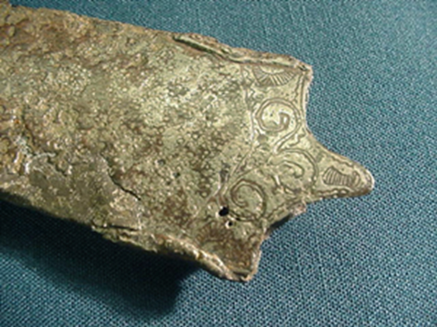
These too are from the actual La Tène site.
Details on sword’s scabbard.
https://www.beloit.edu/logan_online/exhibitions/virtual_exhibitions/before_history/europe /
http://www.archaeology.ru/Download/Harding/Harding_2007_The_Archaeology.pdf

Slide 8
There’s actually an explanation for the fact that artifacts from all over Europe are attributed to La Tène. The site in Switzerland, as was mentioned earlier, yielded an enormous number of artifacts, & it was possible to discern a particular artistic style. Archeologists found similar artifacts from a similar time period in other places, so it is obvious that it was a widespread style, & the fact that we’ve been fortunate enough to find such a large repository in Switzerland doesn’t mean that the style started there. We don’t know where it started.
On the other hand, the discovery of similar artifacts all over Europe does tell us that the people of those times traveled & exchanged ideas & goods. Something we’re going to look at in the next slide show is the fact that the Celts were a people that migrated & spread across areas that are now part of a number of different countries. And that’s before we even get to modern-day Great Britain & Ireland.
As was mentioned earlier, there were more weapons than anything else in the Switzerland La Tène site, so we know that warfare was an important element of Celtic life. The fact that the weapons were ornate & not merely functional suggests that there was a certain prestige that came with being a warrior. But there were other artifacts that tell us more about the society. For example, there were goblets & other feasting items, so we know that celebrations that used these items were part of the society. That should be no surprise to us, since our holidays today frequently center on food. And consider: if a volcano were to cover us with lava today, what would all the travel mugs & non-biodegradable styrofoam cups tell future archeologists about our society?
Another common find in the La Tène hoard was personal adornment (i.e., jewelry). Neck rings, sometimes of gold, are, of course, an indication that there were different strata of society, because not everyone would have had such an ornament. There were other types of jewelry (rings, bracelets, etc.) & a variety of materials, not just metals but also coral, ivory, & amber. Ordinary, practical objects were also found, such as plates, cups, mirrors, combs, etc., although they too normally bore designs.

Slide 9
The La Tène culture was what spread as the Celts began migrating, and, as we might expect, the artifacts in that style help us see the migration patterns, but those artifacts alone are not enough to allow people to post the sign “The Celts were here.” We also rely on, as we saw in the first presentation, ancient texts, and now we also have DNA, although that science is in its infancy.
An important question to ask yourself is this: when we discover La Tène artifacts outside of the Swiss region where the hoard was found, how do we know if the Celts brought them, if people traveled to the Celts & brought the artifacts back, or if someone made them in the location where they were found?
Think about that…but finding the answer is a journey.

